Slide 1
E-retail Factors for Customer Activation and Retention: A Case Study from Indian E-commerce Customers
Problem Statement:
Customer satisfaction has emerged as one of the most important factors that guarantee the success of online store; it has been posited as a key stimulant of purchase, repurchase intentions and customer loyalty. A comprehensive review of the literature, theories and models have been carried out to propose the models for customer activation and customer retention. Five major factors that contributed to the success of an e-commerce store have been identified as: service quality, system quality, information quality, trust and net benefit. The research furthermore investigated the factors that influence the online customers repeat purchase intention. The combination of both utilitarian value and hedonistic values are needed to affect the repeat purchase intention (loyalty) positively. The data is collected from the Indian online shoppers. Results indicate the e-retail success factors, which are very much critical for customer satisfaction.

Slide 2
Aim:
To identify the e-retail success factors, which are very much important for customer satisfaction.
Major factors that contributed to the success of an e-commerce store are:
Service Quality
System Quality
Information Quality
Trust and
Net Benefit

Slide 3
Service Quality
Service quality is a measure of how an organization delivers its services compared to the expectations of its customers
Reliability, responsiveness, assurance, empathy, tangibles and usability are the factors that impact service quality. The customers consider all six of these factors when judging a service system's quality.
System Quality
System quality used as an interacting medium between customers and organizations and played a key role in e-commerce success. system quality of websites is total sum of individual consumers’ perceptions about website availability, adaptability and response time. If the system is available when it required and provided quick response to the end users.
The factors of search function, rating function, review function and product recommended function are selected as the dimensions of system quality. The objective of system quality is to investigate the relationship between these factors on customer satisfaction in buying E-Commerce products.

Slide 4
Information Quality
"Information quality" is a measure of the value which the information provides to the user of that information. The seven factors that affect consumer's online shopping buying behavior are perceived ease of use, perceived risk, perceived usefulness, effect of website design, Economic factor, availability of products, and customer satisfaction.
Trust and Net Benefit
Trust and satisfaction are essential ingredients for successful business relationships in business-to-consumer electronic commerce.
It not only considers how consumers formulate their pre-purchase decisions, but also how they form their long-term relationships with the same website vendor by comparing their pre-purchase expectations to their actual purchase outcome. The results indicate that trust directly and indirectly affects a consumer’s purchase decision in combination with perceived risk and perceived benefit, and also indicate that trust has a longer term impact on consumer e-loyalty through satisfaction.

Slide 5
Exploratory Data Analysis
E-retail factors for customer activation and retention: A case study from Indian e-commerce customers
The given data set consists of 269 rows and 71 columns
Checking for data type:
To check the type of data i have performed df.info () either you can also use code as df.dtypes
The output is all the columns are of object/categorical data type except for pincode column which is of int type
Checking for the null values:
The code for checking the null values is df.is null().sum()
No null values found in the data frame

Slide 6
To check the list of columns used the code df.colums
The list of columns area as follows:
1Gender of respondent', '2 How old are you? ', '3 Which city do you shop online from?', '4 What is the Pin Code of where you shop online from?', '5 Since How Long You are Shopping Online ?', '6 How many times you have made an online purchase in the past 1 year?', '7 How do you access the internet while shopping on-line?', '8 Which device do you use to access the online shopping?', '9 What is the screen size of your mobile device?\t\t\t\t\t\t ', '10 What is the operating system (OS) of your device?\t\t\t\t ', '11 What browser do you run on your device to access the website?\t\t\t ', '12 Which channel did you follow to arrive at your favorite online store for the first time? ', '13 After first visit, how do you reach the online retail store?\t\t\t\t ', '14 How much time do you explore the e- retail store before making a purchase decision? ', '15 What is your preferred payment Option?\t\t\t\t\t ', '16 How frequently do you abandon (selecting an items and leaving without making payment) your shopping cart?\t\t\t\t\t\t\t ', '17 Why did you abandon the “Bag”, “Shopping Cart”?\t\t\t\t\t ', '18 The content on the website must be easy to read and understand', '19 Information on similar product to the one highlighted is important for product comparison', '20 Complete information on listed seller and product being offered is important for purchase decision.', '21 All relevant information on listed products must be stated clearly',

Slide 7
'22 Ease of navigation in website', '23 Loading and processing speed', '24 User friendly Interface of the website', '25 Convenient Payment methods', '26 Trust that the online retail store will fulfill its part of the transaction at the stipulated time', '27 Empathy (readiness to assist with queries) towards the customers', '28 Being able to guarantee the privacy of the customer', '29 Responsiveness, availability of several communication channels (email, online rep, twitter, phone etc.)', '30 Online shopping gives monetary benefit and discounts', '31 Enjoyment is derived from shopping online', '32 Shopping online is convenient and flexible', '33 Return and replacement policy of the e-tailer is important for purchase decision', '34 Gaining access to loyalty programs is a benefit of shopping online', '35 Displaying quality Information on the website improves satisfaction of customers', '36 User derive satisfaction while shopping on a good quality website or application', '37 Net Benefit derived from shopping online can lead to users satisfaction', '38 User satisfaction cannot exist without trust', '39 Offering a wide variety of listed product in several category', '40 Provision of complete and relevant product information', '41 Monetary savings', '42 The Convenience of patronizing the online retailer', '43 Shopping on the website gives you the sense of adventure', '44 Shopping on your preferred e-tailer enhances your social status', '45 You feel gratification shopping on your favorite e-tailer', '46 Shopping on the website helps you fulfill certain roles', '47 Getting value for money spent', 'From the following, tick any (or all) of the online retailers you have shopped from; ', 'Easy to use website or application', 'Visual appealing web-page layout', 'Wild variety of product on offer', 'Complete, relevant description information of products', 'Fast loading website speed of website and application', 'Reliability of the website or application', 'Quickness to complete purchase', 'Availability of several payment options', 'Speedy order delivery ', 'Privacy of customers’ information', 'Security of customer financial information', 'Perceived Trustworthiness', 'Presence of online assistance through multi-channel', 'Longer time to get logged in (promotion, sales period)', 'Longer time in displaying graphics and photos (promotion, sales period)', 'Late declaration of price (promotion, sales period)', 'Longer page loading time (promotion, sales period)', 'Limited mode of payment on most products (promotion, sales period)', 'Longer delivery period', 'Change in website/Application design', 'Frequent disruption when moving from one page to another', 'Website is as efficient as before', 'Which of the Indian online retailer would you recommend to a friend?

Slide 8
The important columns that we have to consider to analyze the success of E-commerce stores are:
customer_info=['Gender of respondent','How old are you?','Which city do you shop online from?', What is the Pin Code of where you shop online from?','Since How Long You are Shopping Online ?', 'How many times you have made an online purchase in the past year?‘]
Website_information=['Easy to use website or application', 'Visual appealing web-page layout', 'Wild variety of product on offer', 'Complete, relevant description information of products‘, 'Fast loading website speed of website and application', 'Reliability of the website or application', 'Quickness to complete purchase', 'Availability of several payment options', 'Privacy of customers’ information', 'Security of customer financial information', 'Perceived Trustworthiness', 'Presence of online assistance through multi-channel']
Negative_remarks=['Longer time to get logged in (promotion, sales period)', ’Longer time in displaying graphics and photos (promotion, sales period)', 'Late declaration of price (promotion, sales period)', 'Longer page loading time (promotion, sales period)', 'Limited mode of payment on most products (promotion, sales period)', 'Longer delivery period', 'Change in website/Application design', 'Frequent disruption when moving from one page to another']
&

Slide 9
Why did you abandon the “Bag”, “Shopping Cart”
You feel gratification shopping on your favorite e-tailer
Gaining access to loyalty programs is a benefit of shopping online
Speedy order delivery
Univariate Analysis:
Univariate analysis is the simplest form of analyzing data. “Uni” means “one”, in other words your data has only one variable. It doesn’t deal with causes or relationships and it’s major purpose is to describe; It takes data, summarizes that data and finds patterns in the data.
Firstly I am performing Univariate analysis for customer_info. It consists of multiple columns , In order to perform univariate analysis for all the columns at a time I am using for lopp

Slide 10
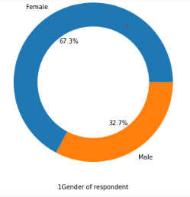
From the above chart we analyze that the highest percentage who prefering online shopping is female than Male/men
for i in customer_info:
if i!='4 What is the Pin Code of where you shop online from?':
plt.figure(figsize=(8,6))
df[i].value_counts().plot.pie(autopct='%1.1f%%')
centre=plt.Circle((0,0),0.7,fc='white')
fig=plt.gcf()
fig.gca().add_artist(centre) plt.xlabel(i)
plt.ylabel('')
plt.figure()

Slide 11
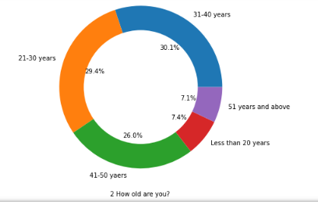
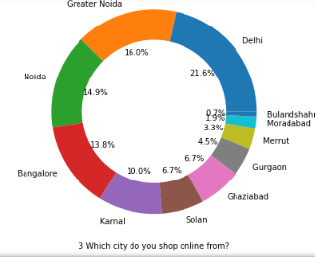
The people at the age of 31-40 years shopping more than other age groups, the age group of less than 20 yrs and more than 51 years are less in number
Most of the people from the cities of Delhi, Noida, greater noida, banglore are choosing online shopping for purchasing the products,

Slide 12
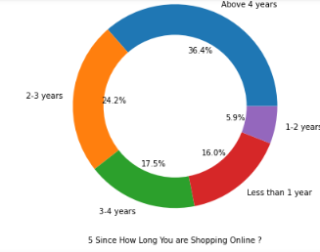
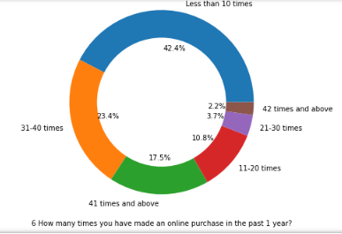
Most of the people shopping online have been shopping from a long time.
Majority of people shop online is less than 10 times a year, amiguity can also be seen for range 42 times and above which needs to be handled

Slide 13
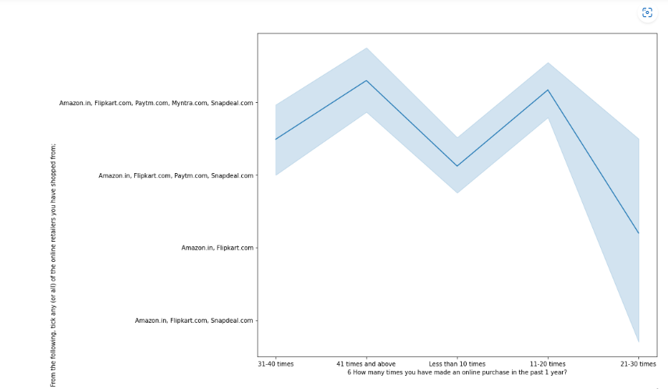
Multivariate Analysis: Here i am performing multivariate analysis for two columns How many times you have made an online purchase in the past 1 year? VS From the following, tick any (or all) of the online retailers you have shopped from
#From the above plot we analyze that more shoppers who shop more than 41 times a year shop from all the online brands, some of the people who shop for 31-40 and less than 10 times a year seem to exclude myntra. some of the people who shop for 21-30 times a year shop from Amazon and flipkart

Slide 14
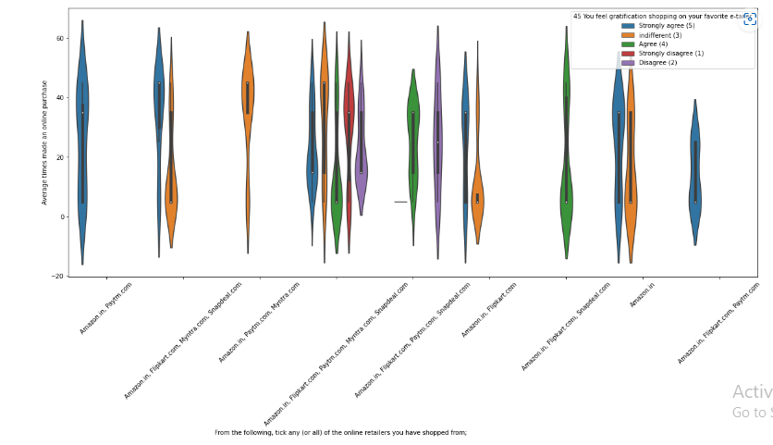
Performing analysis for the following columns: From the following, tick any (or all) of the online retailers you have shopped from; VS Average times made an online purchase, hue- 45 You feel gratification shopping on your favorite e-tailer
Almost all the people who have shopped from amazon, flipkart and paytm are satisfied. People who shop from a more number of online brands doesn't seem to be satisfied.

Slide 15
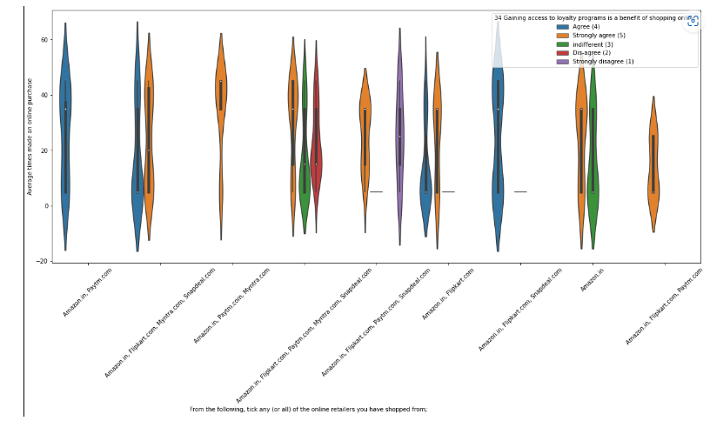
Performing analysis for the following columns: From the following, tick any (or all) of the online retailers you have shopped from; VS Average times made an online purchase, hue-Gaining access to loyalty programs is a benefit of shopping online
People shopping from amazon and paytm are getting benefits from the loyalty points, flipkart and sanpdeal also seem to give such benefits but people who shop from almost everywhere disagree with this statement too

Slide 16
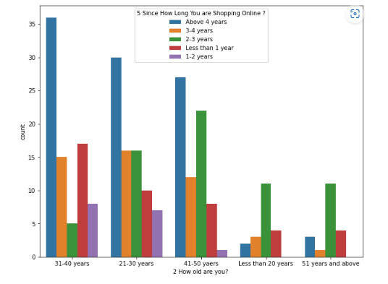
Performing analysis on the column-How old are you, with hue-Since How Long You are Shopping Online ?
Highest number of people have been shopping online for above 4 years except for the age group below 20 years and above 50 years. People who are shopping online for 1-2 years does not include teenagers and elder people

Slide 17
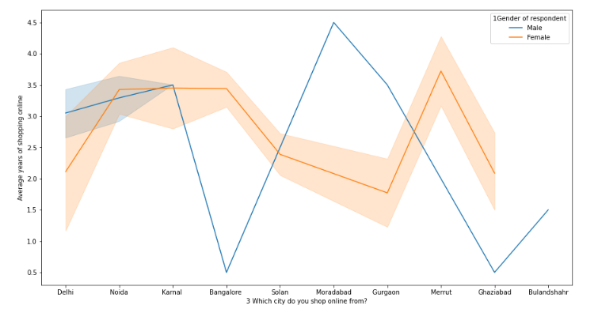
Performing analysis on the following columns: Which city do you shop online from?, Average years of shopping online, hue- Gender of respondent
From the above plot, we can see that density of female customers is more than male. Men living in banglore and ghaziabad have shopped online for less than 1 year. Highest number of men shopping online belong from delhi and noida, while men from moradabad have been shopping online for the longest. Women from meerut and noida have shopped the longest and women living in Solan, gurgaon and delhi shopped online between 2 to 2.5 year

Slide 18
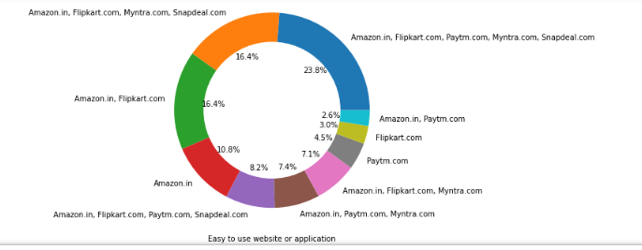
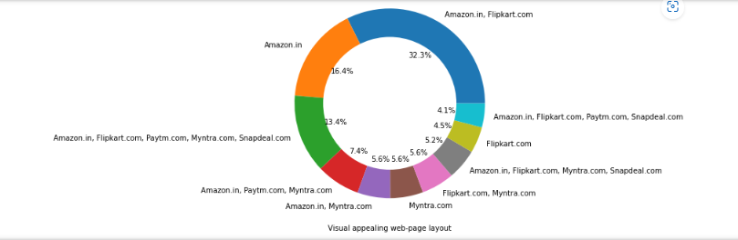
Performing univariate analysis on Website_information
Easy to use website or application
Visual appealing web-page layout', 'Wild variety of product on offer

Slide 19
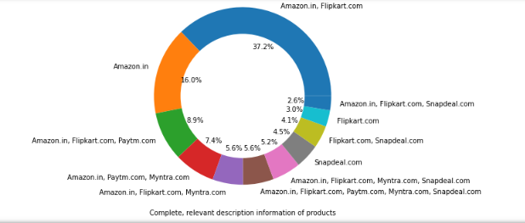
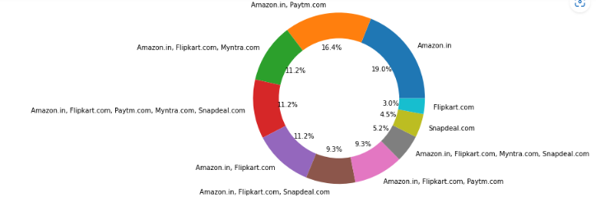
Complete, relevant description information of products
Reliability of the website or application

Slide 20
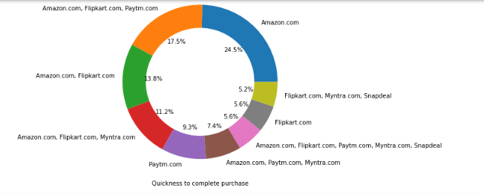
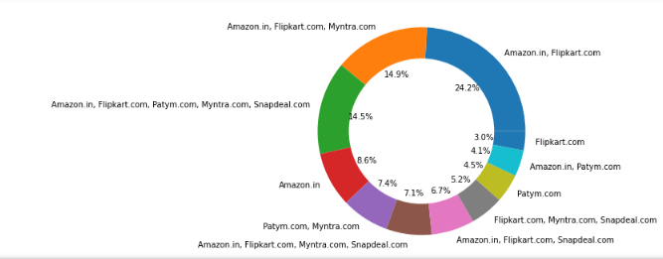
Quickness to complete purchase
Availability of several payment options

Slide 21
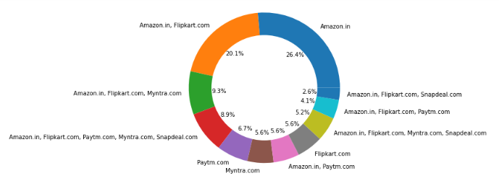
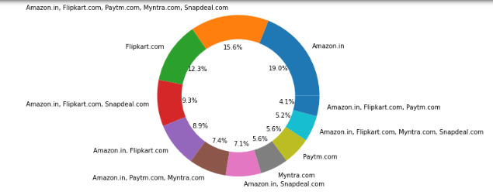
Privacy of customers’ information
Security of customer financial information

Slide 22
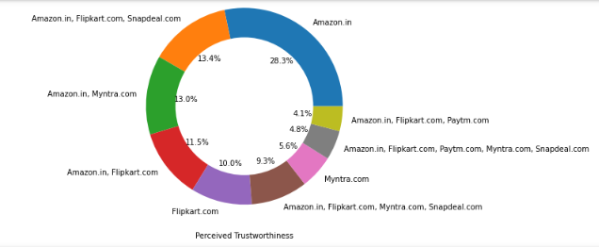
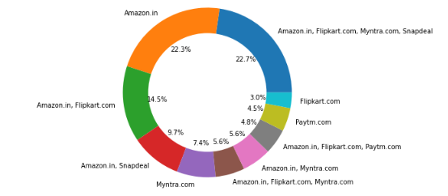
Perceived Trustworthiness
Presence of online assistance through multi-channel
From the plots I have analyzed that Amazon, Flipkart have been had the highest votes for having all the positive points and have maintained a very good brand image followed by paytm and the myntra

Slide 23
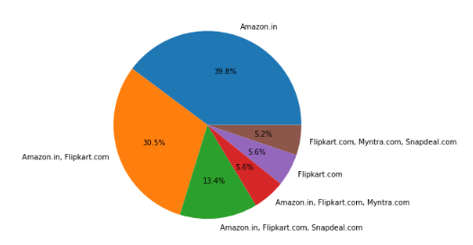
Speedy Order Delivery:
#Amazon and flipkart delivering the products fastly compare to myntra and snapdeal.com

Slide 24
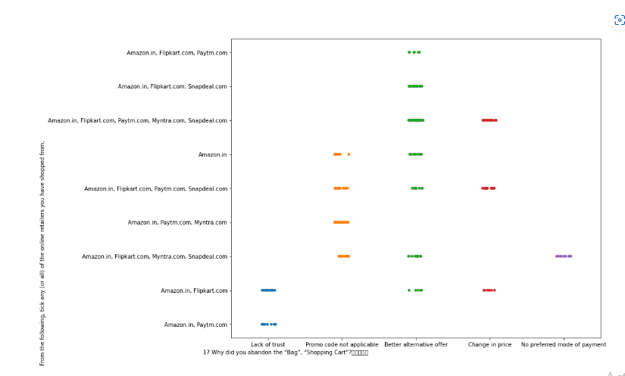
Performing Bivariate Analysis on the following columns- Why did you abandon the “Bag”, “Shopping Cart, From the following, tick any (or all) of the online retailers you have shopped from;
We can clearly see that most of the time people abandon the bag is beacuse they get a better alternative offer or promo code not applicable. There is also lack of trust seen in amazon, flipkart and paytm by some people

Slide 25
On performaing univariate analysis on Negative_remarks we predict that Customers seem to be more loyal to amazon, flipkart and paytm as even though many of them have given negative remarks about them still they would recommend these platforms to their friend.
Conclusion:
The cost of the product, the reliability of the E-commerce company and the return policies all play an equally important role in deciding the buying behaviour of online customers. The cost is an important factor as it was the basic criteria used by online retailers to attract customers. The reliability of the E-commerce company is also important, as it is even required in offline retail. It is important because customers are paying online, so they need to be sure of security of the online transaction. The return policies are important because in online retail customer does not get to feel the product. Thus, he wants to be sure that it will be possible to return the product if he does not like it in real. Whereas, the logistics factor, which included Cash on delivery option, One day delivery and the quality of packaging plays a secondary role in this process though these are Must-be-quality. This is so because these all does not interfere with the real product and people believe that this is the basic value that E-commerce websites provide.
All the websites were not equally preferred by online customers. Amazon was the most preferred followed by Flipkart. This can be explained easily by previous result that we got. These two companies are most trusted in the industry and hence, have a huge reliability. Also, the sellers listed on these websites are generally from Tier 1 cities as compared to Snapdeal and PayTM which have more sellers from tier 2 and 3 cities. Also, these websites have the most lenient return policies as compared to others and also the time required to process a return is low for these companies.

Slide 26
Thank You

